Slide 1
Supply Chain Management
"Optimizing Supply Chain Management using Machine Learning to Address Supply Chain Disruptions in Instant Noodles Delivery"
By Hasna Akbar Ali

Slide 2
Problem Statement
Supply-Demand Mismatch: An FMCG company entered the instant noodles market two years ago. However, they've encountered a challenge with a mismatch between high demand and low supply, and vice versa, across their warehouses.
Inventory Cost Loss: This discrepancy between demand and supply has led to inventory cost losses. In regions with high demand, there's insufficient supply, while low-demand regions experience excess inventory, both resulting in financial losses.
Optimization Objective: The company's management seeks to optimize the supply quantities in each warehouse. The goal is to strike a balance between supply and demand, minimizing inventory-related costs, enhancing efficiency, and ultimately maximizing profitability. Data-driven solutions are sought to predict and optimize supply based on historical sales, demand patterns, and other relevant factors.

Slide 3
Data Cleaning
Reformat strings - Ensure consistent and standardized formatting for string data (e.g., capitalization, spacing).
Reformat data types - Convert data to appropriate data types (e.g. object to category) for accurate analysis.
Address missing values - Handle missing data by filling or removing incomplete entries.
Address duplicate values - Identify and remove or manage duplicate records to avoid redundancy.
Address the outliers - Detect and address extreme or unusual values that may skew analysis.
Remove irrelevant observations - Exclude irrelevant or unnecessary columns that do not contribute to the analysis.

Slide 4
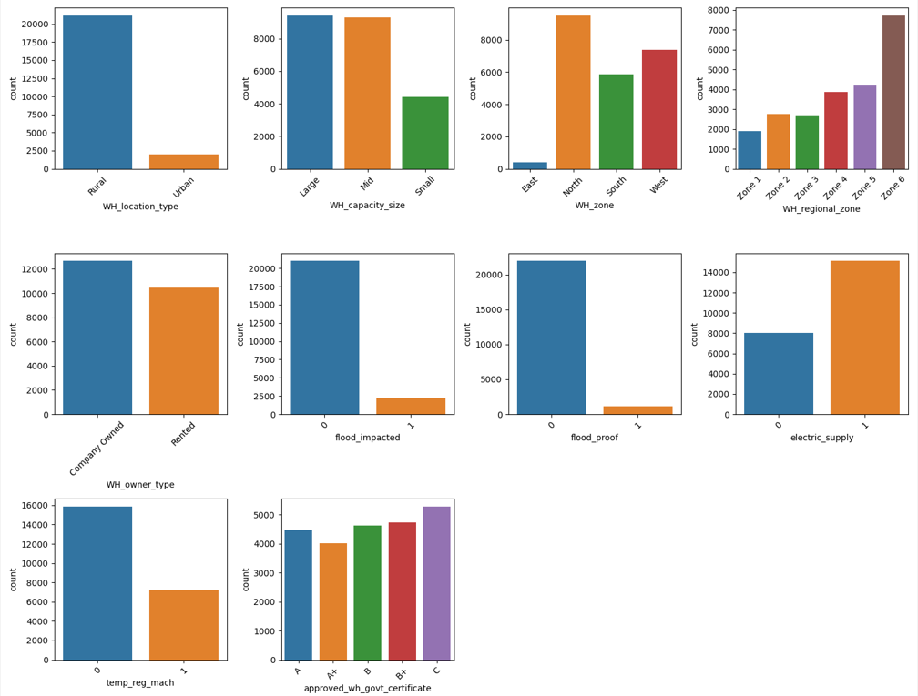
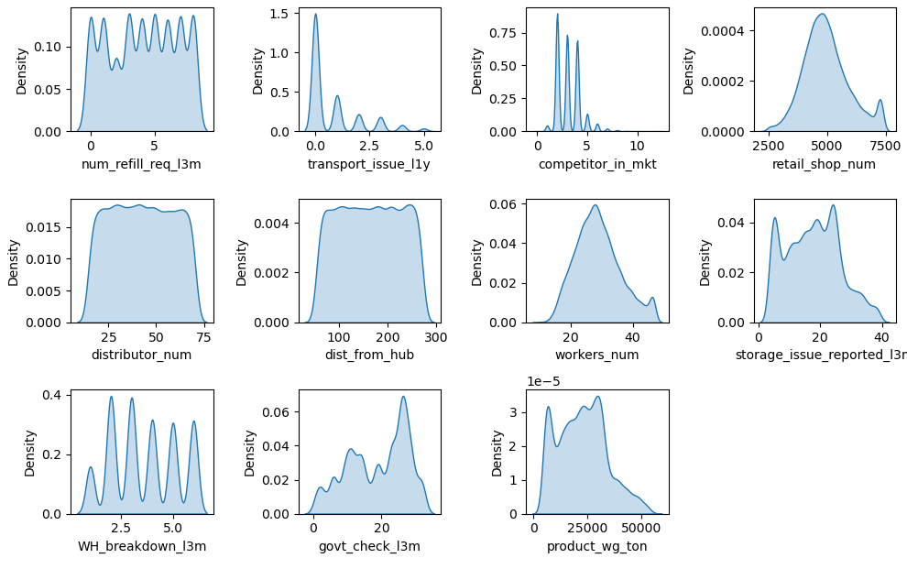
EDA (Exploratory Data Analysis)
Univariate Analysis

Slide 5
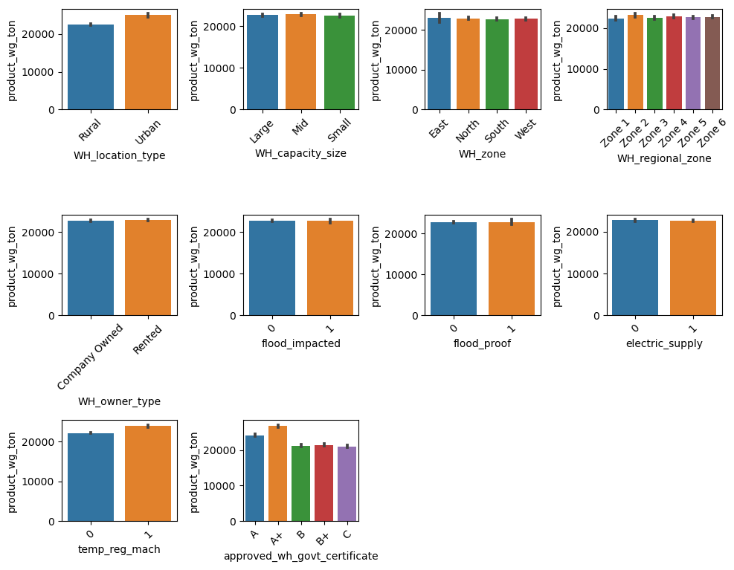
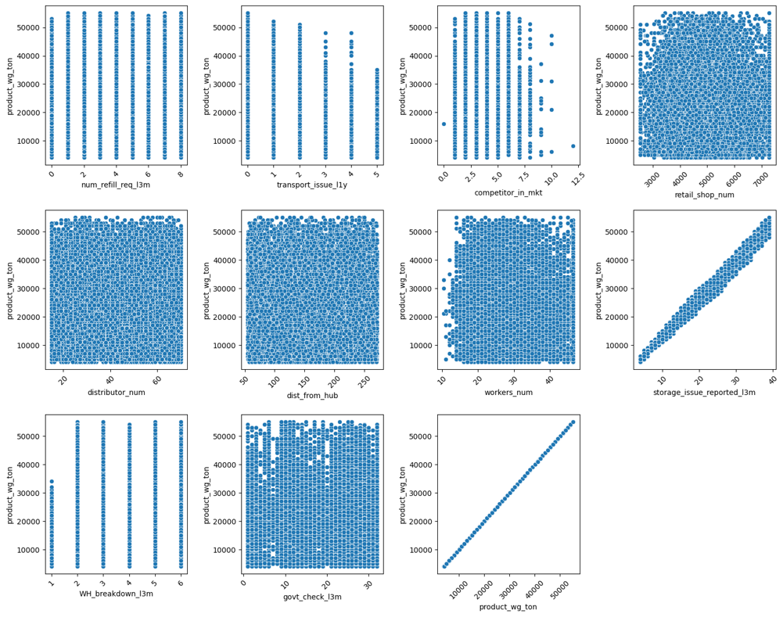
2. Bivariate Analysis

Slide 6
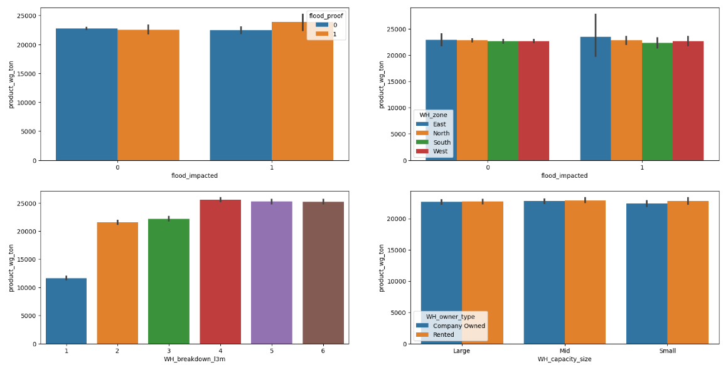
3. Multivariate Analysis

Slide 7
Insights from Analysis
Irrespective of warehouse breakdown, lack of electric supply, lack of temperature regulating machine indicator, areas affected by flood, the same weight of products is being shipped.
Products were shipped to flood impacted areas even though these zones were not flood proof. No Significant difference in weight of shipping products to any of flood impacted zones.
Products should be shipped to warehouses based on different capacity size and owner type. It would be more economical for renting and owning smaller warehouses if the products are shipped based on capacity.
Increase in warehouse breakdowns did not affect the quantity of the product being sold.

Slide 8
Model Selection
Linear Regression - A linear model used to find the best fit line between features and the target variable that has continuous values by finding.
Ridge Regression - Enhances linear model by adding a penalty ie the sum of the absolute values of weights to avoid overfitting.
Lasso Regression - Enhances linear model by adding a penalty ie the sum of the absolute values of weights to avoid overfitting.
Decision tree - A tree-like model to predict the target variable's value based on input features. It recursively partitions the data into subsets by selecting features that best separate the data.
Random Forest Regressor - This model uses multiple decision trees to get more accurate predictions and reduce overfitting.
K-Nearest Neighbors - KNN predicts values based on the majority class or average of k nearest data points, making it simple but sensitive to noise.

Slide 9
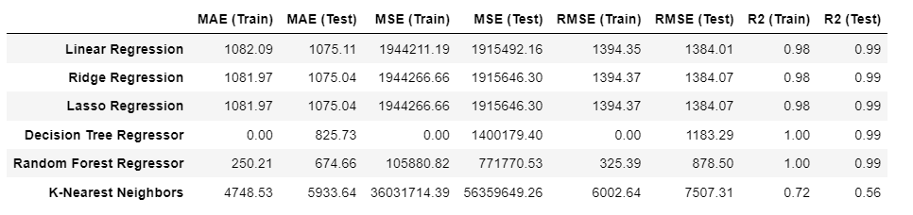
Results of Selected Models

Slide 10
Conclusion
Linear Regression, Ridge Regression, and Lasso Regression provide solid predictive capabilities with minimal variation, showcasing their reliability in capturing linear relationships.
Decision Tree Regressor exhibits considerable overfitting, while Random Forest Regressor offers enhanced accuracy through ensemble learning.
KNN predicts values based on average of k nearest data points, making it simple but sensitive to noise which is why the results are less accurate compared to other regression algorithms.

